Slide 1
OBJECTIVE MORAL TRUTHS?

Slide 2
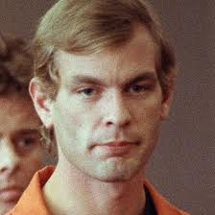
JEFFREY DAHMER

Slide 3
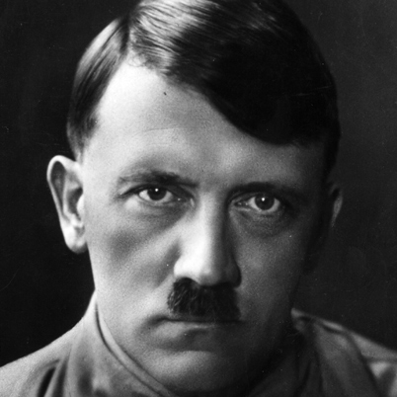
ADOLF HITLER

Slide 4
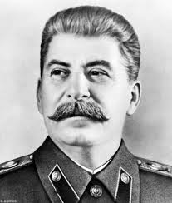
JOSEF STALIN

Slide 5
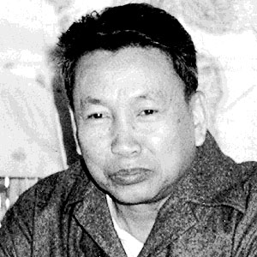
POL POT

Slide 6
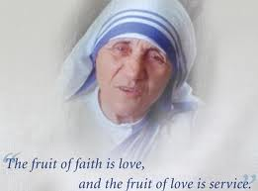
MOTHER TERESA

Slide 7
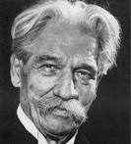
ALBERT SCHWEITZER

Slide 8
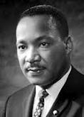
MARTIN LUTHER KING

Slide 9
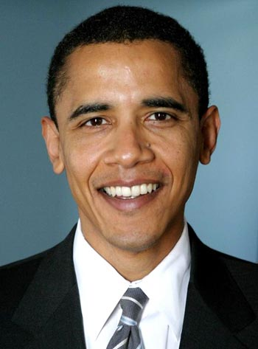
PRESIDENT BARACK OBAMA

Slide 10
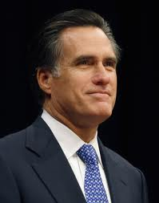
GOVENOR MITT ROMNEY

Slide 11
MORAL ARGUMENTS FOR THEISTIC BELIEF
ROBERT MERRIHEW ADAMS

Slide 12
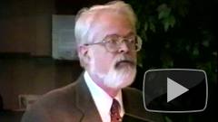
ROBERT M. ADAMS (1937- )

Slide 13
THE ARGUMENT FROM THE NATURE OF RIGHT AND WRONG
THIS AGAIN IS ESSENTIALLY AN ARGUMENT THAT IS MEANT TO BE INDUCTIVELY STRONG.
THE HYPOTHESIS THAT THERE IS A PERFECTLY GOOD BEING IS SUPPOSED TO BE MADE PROBABLE BY ADAMS’S OBSERVATIONS ABOUT MORAL TRUTHS.

Slide 14
AN HYPOTHESIS WHICH IS SUPPOSED TO EXPLAIN CERTAIN “DATA”:
(AH) THERE IS A LOVING GOD WHO IS SUCH THAT RIGHT AND WRONG “CONSIST IN” AGREEMENT OR DISAGREEMENT WITH THE WILL OR COMMANDS OF SUCH A LOVING GOD.

Slide 15
INITIAL (BAD) OBJECTION
“AGREES WITH THE COMMANDS OF GOD” IS NOT WHAT MOST PEOPLE MEAN BY “RIGHT”.
EVEN ATHEISTS MAY BELIEVE THAT SOME THINGS ARE OBJECTIVELY RIGHT (OR GOOD), BUT THEY DON’T BELIEVE IN GOD. SO THEY CERTAINLY DON’T MEAN THIS BY “RIGHT” (SIMILARLY FOR “WRONG”).

